Slide 1
AI Chip and Memory Supply Chain
DATA 620 Final Project Proposal
Andre Thomson
November 1 2026

Slide 2
Why I chose this project
I work in IT, so hardware and memory are easier for me to connect to than a theoretical topic
People often talk about an AI chip as if one company makes it, but it depends on designs, testing tools, fabrication equipment, and packaging technology from suppliers in different countries
My first idea was to study news headlines about chip shortages, but that would measure media coverage, not the supply chain itself
A documented dataset lets me look at the provider-to-input relationships directly, and a network shows where the same country or company appears in more than one part of the chain
2

Slide 3
Research question
Which companies and countries are most connected to five AI chip and memory related inputs, and which of those inputs have the fewest listed providers?
What I expect
Countries will connect more of the network than individual companies
Some advanced inputs will have fewer listed providers than others
These are expectations to examine, not conclusions.
3

Slide 4
The five inputs and what I will compare
Five inputs
I will compare
Discrete GPUs
AI ASICs
Memory chip design
Memory test tools
Fabrication tools for advanced packaging
Providers by how many of these inputs they connect to
Inputs by how many providers they have
Pairs of inputs by how many providers they share
Not compared: production volume, price, or shortage periods. The source does not cover them.
4

Slide 5
Data source
Emerging Technology Observatory (ETO) Semiconductor Supply Chain Dataset, September 2026 release
Center for Security and Emerging Technology, Georgetown University
I downloaded the five CSV tables and checked that they load
126 inputs, 396 unique providers, 1,300 provider-to-input relationships
File | Contents
inputs.csv | Chip designs, tools, materials, processes
providers.csv | Companies and countries
provision.csv | Which provider supplies which input
sequence.csv | Which inputs feed into which
stages.csv | Design, fabrication, assembly/test/packaging
5

Slide 6
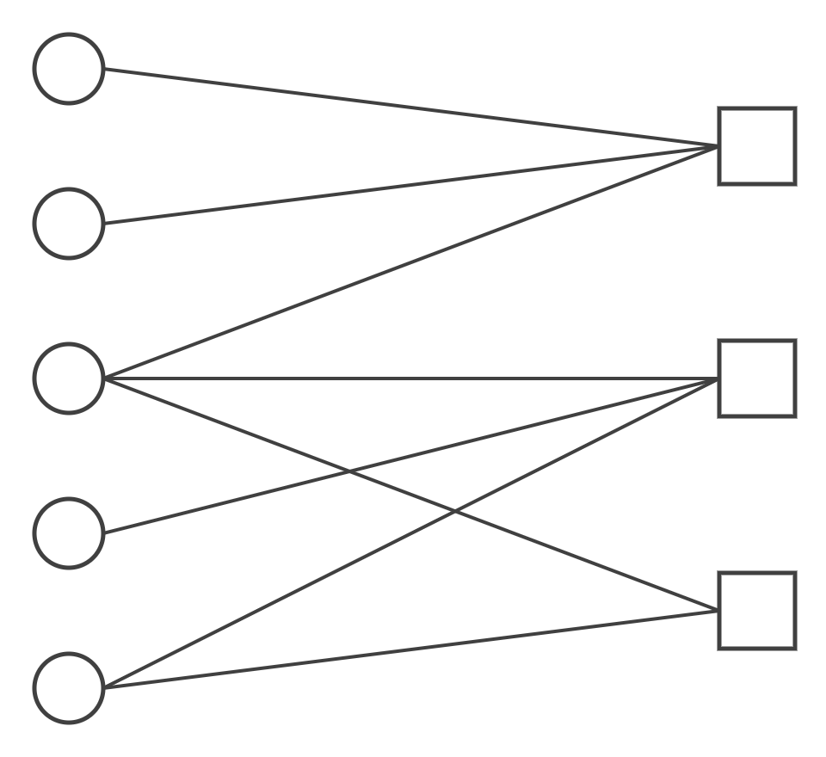
Method
Python, pandas, NetworkX, and Matplotlib in a Jupyter Notebook
Check row counts, missing values, duplicates, and unmatched IDs
Build a bipartite network: providers (companies and countries) on one side, the five inputs on the other; an edge means the dataset lists that provider for that input
Calculate degree and betweenness centrality
Project the network onto the inputs, weighting each edge by the number of shared providers
Use market share only in separate examples, because it is not reported consistently
Providers
Inputs
Example of a bipartite network (not real data)
6

Slide 7
Early data check
Listed providers per input
Every input has listed providers
5 records labeled "Various companies" or "Various countries" will be left out
No unmatched IDs between the tables
Memory chip design lists countries only; if it cannot be compared fairly, I will adjust the focus
Discrete GPUs
2
3
Memory chip design
5
Memory test tools
3
5
AI ASICs
3
8
Advanced packaging tools
13
14
Countries
Companies
7

Slide 8
Concerns and limitations
The dataset is a snapshot with mixed reference years, so it cannot show change over time or prove a shortage
Provider country is the headquarters of the parent company, not where production happens
Aggregate labels such as "Various companies" will be excluded from centrality, and I will report how many records that removes
An edge shows that the publisher lists a provider, not a contract or the amount supplied
8

Slide 9
Plan
Individual project: data checks, code, visualizations, interpretation, and presentation
Deliverables: this proposal, a code-based analysis in Jupyter with an overview and conclusions, and a presentation
If a data check shows one input cannot be compared fairly, I will adjust the focus
Due December 18, 2026, 11:59 PM
9

Slide 10
References: Data and methods
Center for Security and Emerging Technology. (2026). ETO Semiconductor Supply Chain Dataset repository. GitHub. https://github.com/georgetown-cset/eto-chip-explorer/tree/main/data
Emerging Technology Observatory. (2026). Semiconductor Supply Chain Dataset, September 2026 release. https://www.eto.tech/dataset-docs/chipexplorer/index.html
NetworkX Developers. (n.d.). Bipartite. NetworkX documentation. Retrieved November 8, 2026, from https://networkx.org/documentation/stable/reference/algorithms/bipartite.html
NetworkX Developers. (n.d.). Tutorial. NetworkX documentation. Retrieved November 8, 2026, from https://networkx.org/documentation/stable/tutorial.html
NetworkX Developers. (n.d.). Weighted projected graph. NetworkX documentation. Retrieved November 8, 2026, from https://networkx.org/documentation/stable/reference/algorithms/generated/networkx.algorithms.bipartite.projection.weighted_projected_graph.html
Opsahl, T. (2013). Projection. http://toreopsahl.com/tnet/two-mode-networks/projection/
10

Slide 11
References: Learning resources
Codecademy. (n.d.). Learn complex data structures. Retrieved November 8, 2026, from https://www.codecademy.com/learn/complex-data-structures
DigitalSreeni. (2025, March 12). 354—Knowledge graphs in Python using NetworkX library [Video]. YouTube. https://www.youtube.com/watch?v=n7BTWc2C1Eg
Matplotlib Development Team. (n.d.). Tutorials. Matplotlib documentation. Retrieved November 8, 2026, from https://matplotlib.org/stable/tutorials/index.html
NeuralNine. (2023, February 1). NetworkX crash course—Graph theory in Python [Video]. YouTube. https://www.youtube.com/watch?v=VetBkjcm9Go
W3Schools. (n.d.). Python graphs. Retrieved November 8, 2026, from https://www.w3schools.com/python/python_dsa_graphs.asp
11

